Slide 1
Feature Driven Development (FDD)

Slide 2
Introduction
Feature Driven Development (FDD) is one of the Agile Software Development Methodologies.
It is an agile framework that, as its name suggests, this FDD organizes software development by making progress on features.
Features in the FDD context, though, are not necessarily product features in the commonly understood sense.
In other words, “complete the login process” might be considered a feature in the Feature Driven Development (FDD) methodology.

Slide 3
Introduction
FDD is an agile, highly adaptive software development process that is
Highly iterative.
Emphasizes quality at all steps
Delivers frequent, tangible working results at all steps
Provides accurate and meaningful progress along with status information, with the minimum of overhead and disruption for the developers.
Is liked by client, managers and developers

Slide 4
Why do we have to use FDD ?
Communication
Consider developers as nodes in a communication network, all potentially linked to each other by communication channels. The number of potential communication channels increase dramatically as more number of developers are added
Complexity
FDD decomposes the entire problem domain into tiny problems, which can be solved in a small period of time, usually 2 weeks decomposed problems independent to each other reduces the need of communication.
FDD splits the project into iterations so that the distance in time between analysis and test is reduced early discovery of errors reduces the cost of fixing the errors.
Quality
Different persons have different perception of software quality This makes necessity to view quality as a spectrum, with internal quality at one end and external quality at other end.

Slide 5
Roles in FDD
Key Roles
Project Manager (PM)
Chief Architect (CA)
Development Manager (DM)
Chief Programmers
Class Owners
Domain Experts
Supporting Roles
Release Manager
Language Guru
Build Engineer
Toolsmith
System Administrator
Additional Roles
Testers
Deployers
Technical Writer

Slide 6
Contd…
Project manager oversees the entire project, and uses traditional rather than agile management techniques.
Development manager deals with the day-to-day activities. S/he is often the developers’ line manager and also functions as a mentor for less experienced team members.
Chief architect is in charge of the overall design of the system and guides the domain experts and developers in their work during the initial and iterative design steps.

Slide 7
Contd…
Chief programmer is an experienced developer who assists teams with analysis and design during the design and build steps. It helps the class owners and other developers to keep the code base consistent in its application of software design principles. It may also manage small development teams.
Class owner is any developer responsible for designing, coding, testing, and documenting a class that implements part of the domain object model in code.
Domain expert understands the customer’s business in general and the part that the new product (system) will support in particular. S/he helps the development teams understand how the business operates and what it needs. S/he usually comes from the customer’s organization.

Slide 8
FDD - Practices
Domain Object Modeling
The Problem is broken down into the significant objects involved.
The design and implementation of each object or
class identified in the model is a smaller problem to solve.
Completed classes are combined, Form the solution to the larger problem
Best technique for domain object modeling is,
M o d e l i n g
I n C o l o r

Slide 9
FDD - Practices
UML in Color
All classes are divided into different categories with its own color code.
a role being played.
by a person or an organization, example: a user of an online auction may play different roles as a buyer or seller.
a catalogue like description.
example: a description of smart phones that sells in auction.
a party, place or thing.
example: the smart phones in stock would be modeled as green. This class usually has some identifying attributes such as serial no, persons name, etc.
a moment in time or time associated with some business process.
example: the fact of purchase may be shown a pink class, since it has a time of sale which is tracked by the online store,

Slide 10
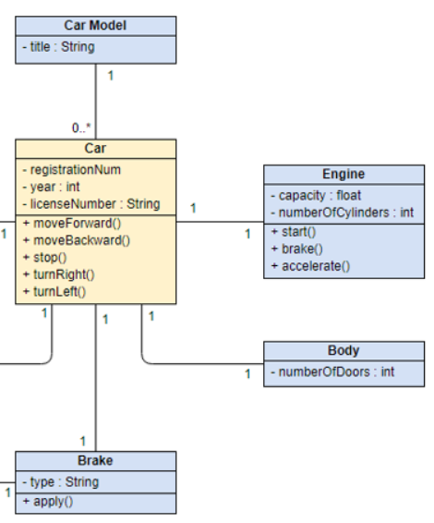
Class Diagram – An Example

Slide 11
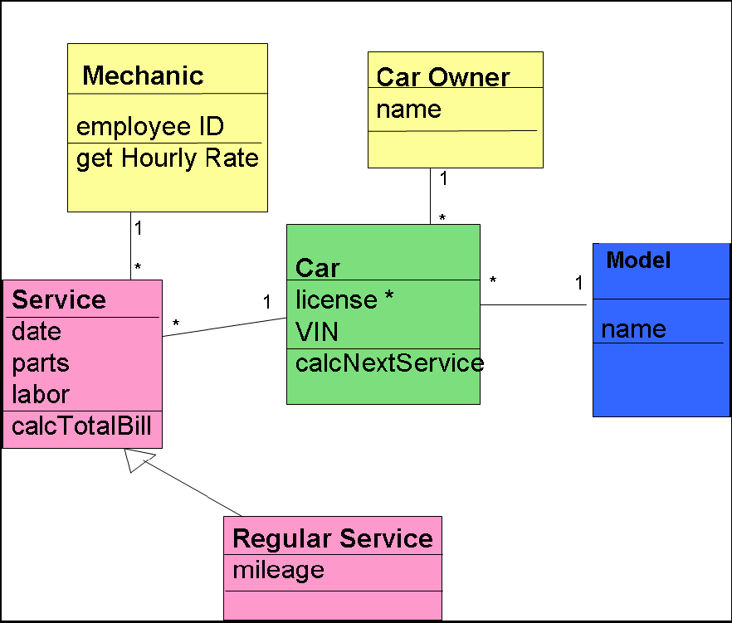
FDD - Practices
UML in Color
All classes are divided into different categories with its own color code.
a role being played.
a catalogue like description.
a party, place or thing.
a moment in time or time associated with some business process.

Slide 12
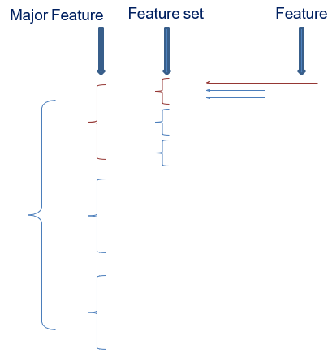
FDD - Practices
What is a Feature ?
A feature is a small, client valued function that can be implemented in two weeks
Any function that is too complex to be implemented within two weeks is further decomposed into smaller functions until each sub-problem is small enough to be called a feature.
FDD is an agile software development
methodology.
FDD employs a short-iteration model.
FDD is designed to be used in large
projects and teams.
FDD combines many of the best practices
of other agile methodologies.

Slide 13

FDD - Practices
Developing by Feature
The feature naming template
<action> the <result> <by | for | of | to><a(n)><object>
Example of features:
Calculate <action> the total <result> of a sale <object>
Calculate the total of a sale

Slide 14
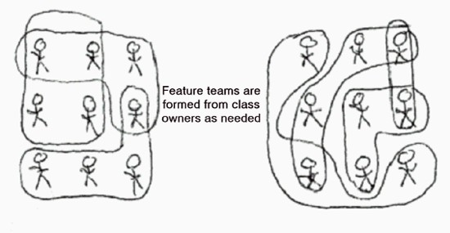
FDD - Practices
Class (code) Ownership
In a development process, class (code) ownership indicates ultimately responsible person for the content of a class (piece of code).
Feature Team
Implementation of a feature may involve more than one class and more than one class owner
As the feature team owns all the code it needs to change for that feature, there is no waiting for members of other teams to change code. So we have code ownership and a sense of collective ownership too. Each member of a feature team contributes to the design and implementation of a feature under the guidance of a skilled, experience developer. This reduces the risk of reliance on key developers or owners of specific classes.

Slide 15
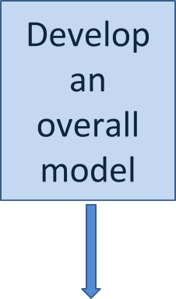
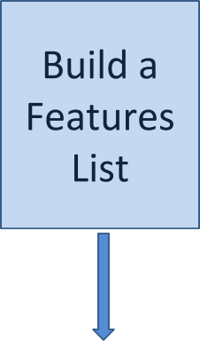
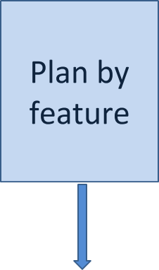
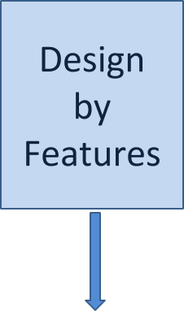
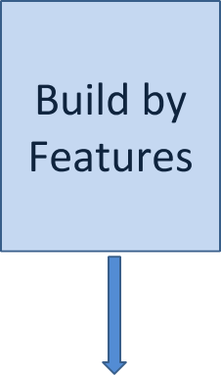


Processes
FDD Life Cycle consist five processes
Process

Slide 16
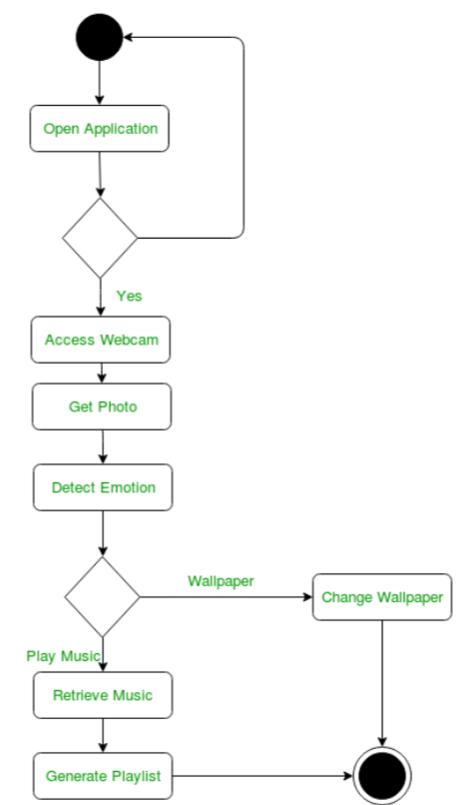
Activity Diagram- An Example

Slide 17

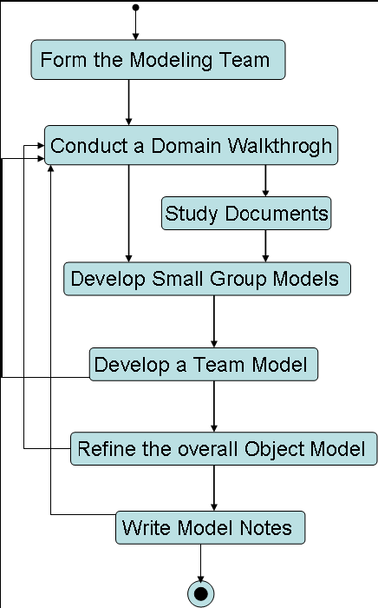
Processes
Entry Criteria
Domain experts, Chief Programmers and the Chief Architect have been selected.
Exit Criteria
Class diagrams focusing on model shape. That is, what classes are in the domain, how are they connected to one another and under what constraints.
Methods and attributes identified are placed in the classes.
Sequence Diagram(s), if any.
Model notes to capture why a particular model shape was chosen and/or what alternatives were considered

Slide 18
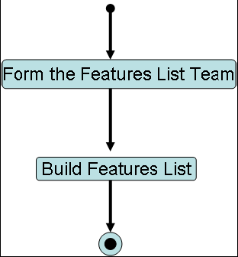
Processes
A team consist of Chief Programmers from process are formed to decompose the domain functionality.
The team breaks the domain into a number of areas (major feature Sets), based on the partitioning of the domain by the Domain Experts in process
Each area is further broken into a number of activities (feature sets).
Each step within an activity is identified as a feature.
Exit Criteria
A list of subject areas
For each subject area, a list of the business activities within that subject area
For each business activity step, the feature to satisfy the step

Slide 19
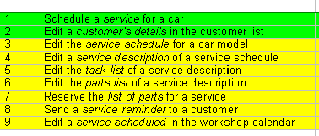

Slide 20

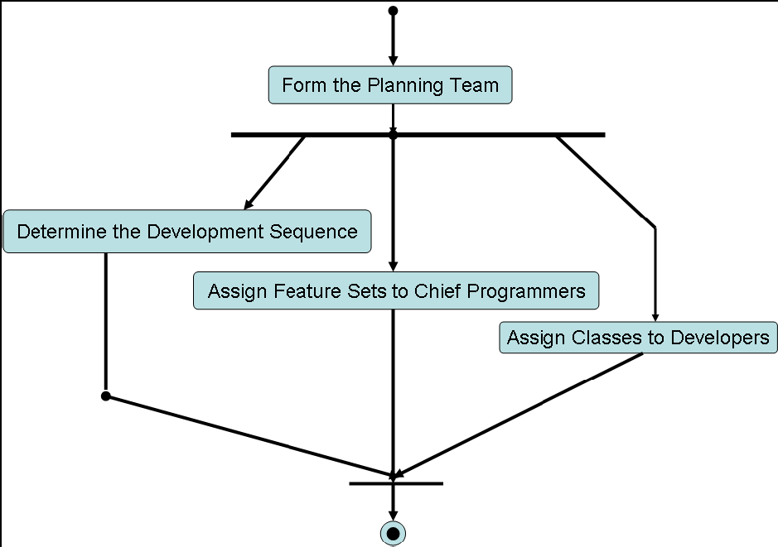
Processes
The project Manager, Development Manager, and Chief Programmers plan the order that the features are to be implemented, based on feature dependencies, load across the development team, and the complexity of the features to be implemented.
Exit Criteria
Business activities with completion dates (month and year)
Chief programmers assigned to business activities
Subject areas with completion dates (month and year) derived from the last completion date of their respective business activities
The list of classes and the developers that own them (the class owner list)

Slide 21


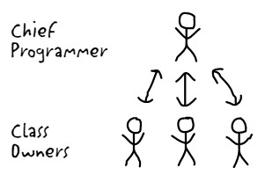
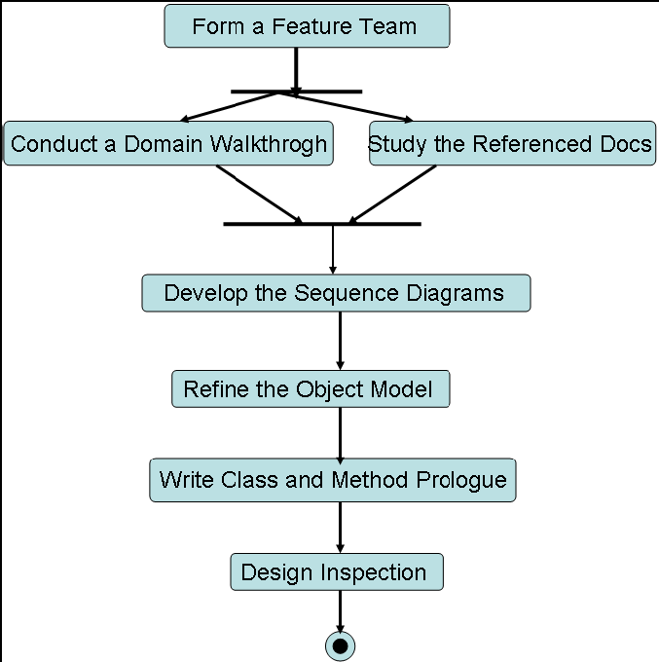

Processes
Feature Team
Exit Criteria
A covering memo, or paper, that integrates and describes the design package such that it stands on its own for reviewers.
The referenced requirements (if any) in the form of documents and all related confirmation memos and supporting documentation.
The Sequence diagram(s).
Design alternatives (if any)
The object model with new/updated classes, methods and attributes.

Slide 22

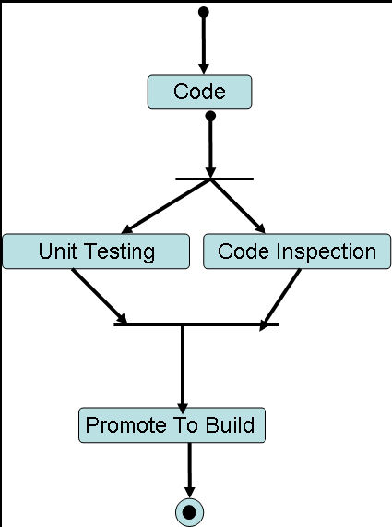
Processes
Class owners implement the items necessary for their class to support the design for the feature(s) in the work package, based on the design package produced during the Design by Feature process.
The developed code which is determined by the Chief Programmer is tested and inspected.
After a successful code inspection, the code is permitted to build.
Exit Criteria
Class(es) and/or method(s) that have been successfully code inspected.
Class(es) that have been promoted to the build.
The completion of a client-valued function (feature)

Slide 23

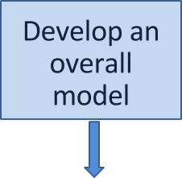
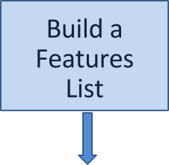
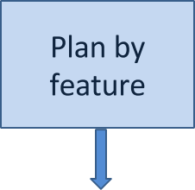
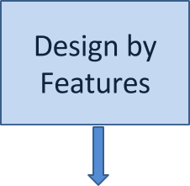
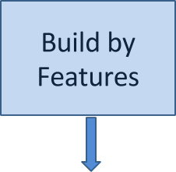







Processes
Guidelines for time spent in each process
Process

Slide 24
FDD Progress
FDD does not ask feature teams for a percentage of completeness. FDD tells feature teams what percentage complete they are.
FDD uses six sharply defined milestones to track progress of each feature through process IV and V, Design by Feature (DBF) and Build by Feature (BBF)
The last three milestones are completed during the BBF process. The six milestones are completed sequentially for each feature being developed.
percentage weighting
A percentage weighting is assigned to each milestone. So we can say that a feature that has reached the coding stage is completed for this much percentage. The weighting percentages assigned to each milestone varies from situation to situation, depending upon the level of effort put into it.
These six milestones are as follows:

Slide 25





Progress
Reporting to Chief programmers and Project Manager
Major Feature Set – “Workshop Management Area”
Feature Set | No of features | No of Not started | No of In progress | No of Completed | % completed

Slide 26

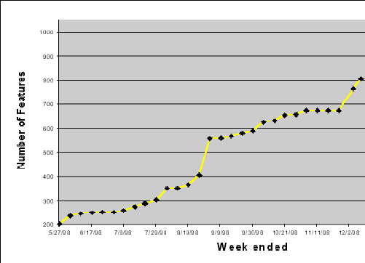
Progress
Reporting to Chief programmers and Project Manager
Every week, the rate of progress is shown by plotting a graph for the number of features completed each week

Slide 27

Advantages of FDD
Advantages
Supports multiple teams working in parallel All aspects of a project tracked by a feature
Design by feature and build by a feature aspects are easy to understand and adopt Scales to large teams or projects well
Better in teams where developers’ experiences varies
Offers well defined progress tracking and reporting capabilities

Slide 28

Disadvantages of FDD
Disadvantages
Promotes individual code ownership as opposed to shared/team ownership Iterations are not well defined by the process as other agile methodologies The model-centric aspects can have huge impacts when working on existing
systems that have no models.

